Slide 1
Data Mining
BY
Adnan Amin

Slide 2
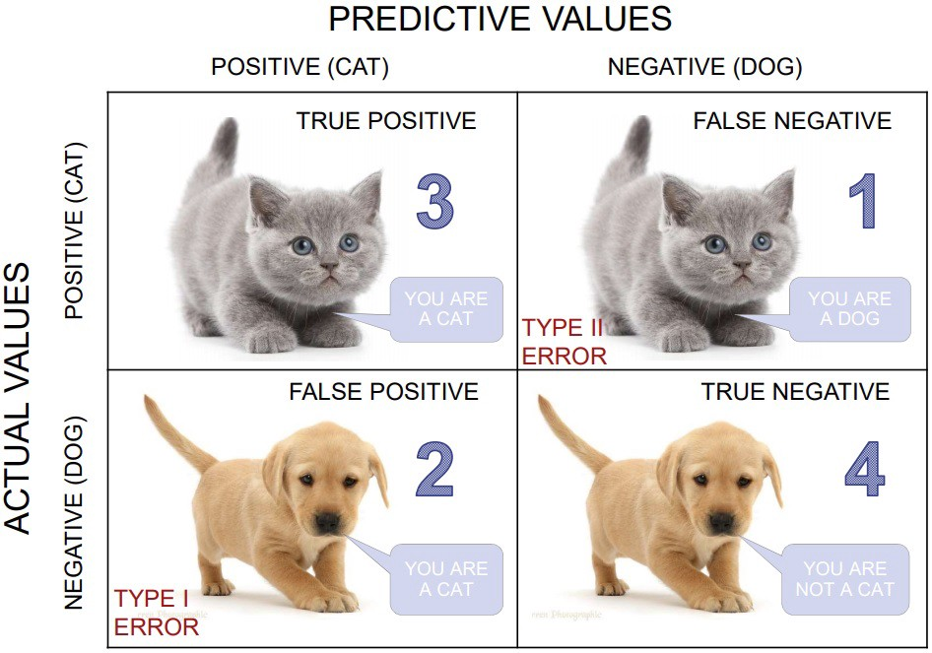
Confusion Matrix
After data preparation and model training, there is model evaluation phase.
In model evaluation phase, need to calculate the performance of the developed model using some evaluation metrics.
Confusion Matrix is a tool to determine the performance of classifier.
It contains information about actual and predicted classifications.
It is extremely useful for calculating precision, recall, F1 score, accuracy.

Slide 3
Confusion Matrix
Confusion Matrix
Actual Class | Predicted Class
 |  | Positive | Negative
 | Positive | True Positive (TP) | False Negative (FN)
 | Negative | False Positive (FP) | True Negative (TN)

Slide 4
Confusion Matrix
Confusion Matrix
Actual Class | Predicted Class
 |  | Positive | Negative
 | Positive | True Positive (TP) | False Negative (FN)
 | Negative | False Positive (FP) | True Negative (TN)

Slide 5
Confusion Matrix
Actual Class | Predicted Class
 |  | Positive | Negative
 | Positive | True Positive (TP) | False Negative (FN)
 | Negative | False Positive (FP) | True Negative (TN)

Slide 6
Confusion Matrix
Confusion Matrix
You predicted positive and it’s true.
Actual Class | Predicted Class
 |  | Positive | Negative
 | Positive | True Positive (TP) | False Negative (FN)
 | Negative | False Positive (FP) | True Negative (TN)

Slide 7
Confusion Matrix
You predicted positive and it’s true.
Actual Class | Predicted Class
 |  | Positive | Negative
 | Positive | True Positive (TP) | False Negative (FN)
 | Negative | False Positive (FP) | True Negative (TN)
You predicted negative and it’s true.

Slide 8
Confusion Matrix
You predicted Negative and it’s false.
You predicted positive and it’s true.
incoming event (or saying a Dog is a Cat)
Actual Class | Predicted Class
 |  | Positive | Negative
 | Positive | True Positive (TP) | False Negative (FN)
 | Negative | False Positive (FP) | True Negative (TN)

Slide 9
Confusion Matrix
Confusion Matrix
You predicted positive and it’s true.
Actual Class | Predicted Class
 |  | Positive | Negative
 | Positive | True Positive (TP) | False Negative (FN)
 | Negative | False Positive (FP) | True Negative (TN)
You predicted positive and it’s false.

Slide 10
Confusion Matrix
Confusion Matrix
Actual Class | Predicted Class
 |  | Positive | Negative
 | Positive | True Positive (TP) | False Negative (FN)
 | Negative | False Positive (FP) | True Negative (TN)
You predicted positive and it’s false.
You predicted negative and it’s true.

Slide 11
Confusion Matrix
You predicted Negative and it’s false.
incoming event (or saying a Dog is a Cat)
Actual Class | Predicted Class
 |  | Positive | Negative
 | Positive | True Positive (TP) | False Negative (FN)
 | Negative | False Positive (FP) | True Negative (TN)
You predicted negative and it’s true.

Slide 12
Confusion Matrix
You predicted Negative and it’s false.
You predicted positive and it’s true.
Actual Class | Predicted Class
 |  | Positive | Negative
 | Positive | True Positive (TP) | False Negative (FN)
 | Negative | False Positive (FP) | True Negative (TN)
You predicted negative and it’s true.

Slide 13
Confusion Matrix
You predicted Negative and it’s false.
You predicted positive and it’s true.
Actual Class | Predicted Class
 |  | Positive | Negative
 | Positive | True Positive (TP) | False Negative (FN)
 | Negative | False Positive (FP) | True Negative (TN)
You predicted positive and it’s false.
You predicted negative and it’s true.

Slide 14
Different variation of Confusion Matrix
Actual Class | Predicted Class
 |  | Positive | Negative
 | Positive | True Positive (TP) | False Negative (FN)
 | Negative | False Positive (FP) | True Negative (TN)
Predicted Class | Actual Class
 |  | Positive | Negative
 | Positive | True Positive (TP) | False Positive (FP)
 | Negative | False Negative (FN) | True Negative (TN)
Actual Class | Predicted Class
 |  | Negative | Positive
 | Negative | True Negative (TN) | False Positive (FP)
 | Positive | False Negative (FN) | True Positive (TP)
Predicted Class | Actual Class
 |  | Negative | Positive
 | Negative | True Negative (TN) | False Negative (FN)
 | Positive | False Positive (FP) | True Positive (TP)

Slide 15
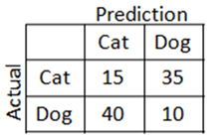
Example
15 Cats as Cats (TN) –
35 Cats as Dogs (FP)
40 Dogs as Cats (FN)
10 Dogs as Dogs (TP)

Slide 16
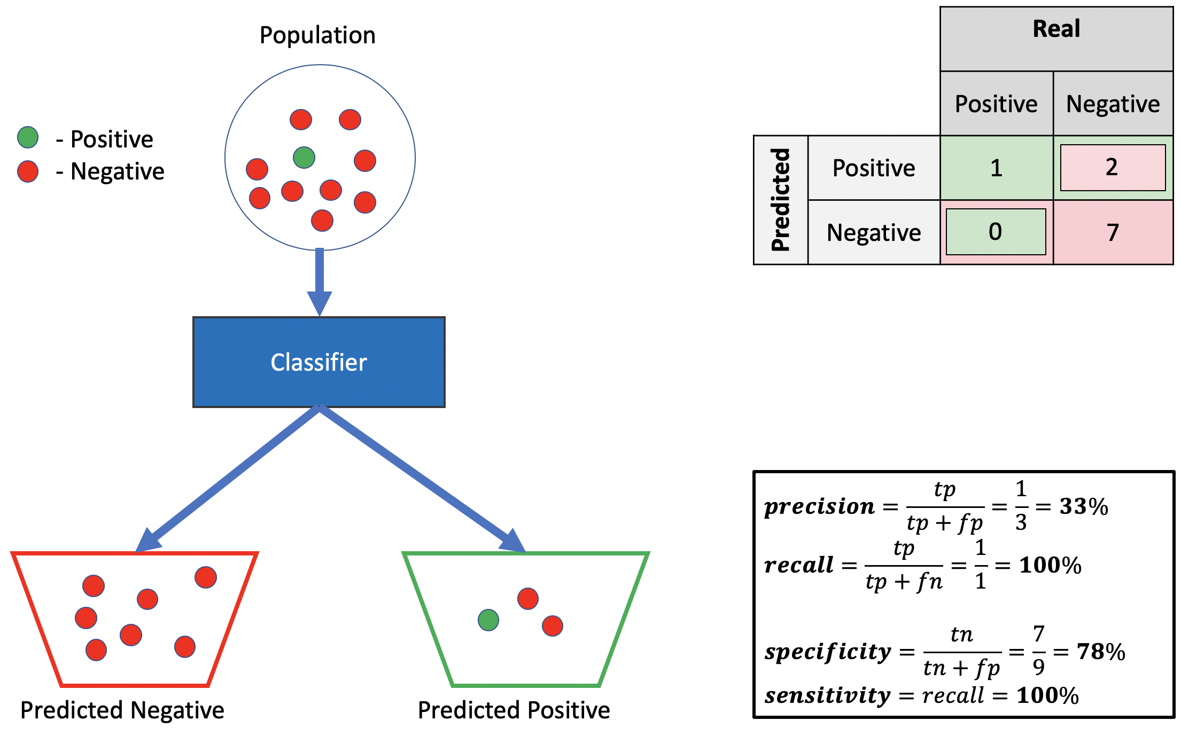

Slide 17
Find and Calculate the Following
Recall
Precision
Accuracy

Slide 18
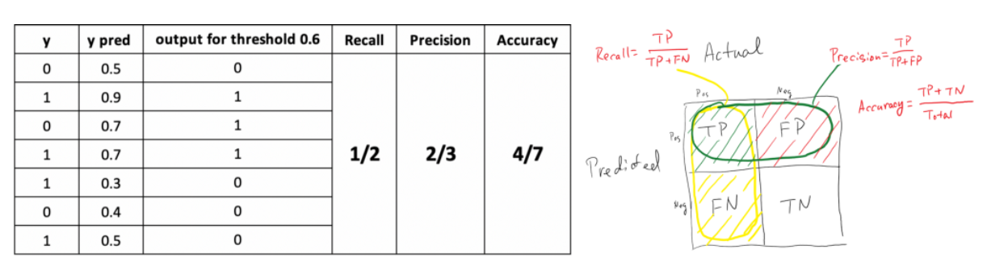
Recall: Out of all the positive classes, how much we predicted correctly. It should be high as possible.
Precision: Out of all the positive classes we have predicted correctly, how many are actually positive.
Accuracy: Out of all the classes, how much we predicted correctly,
https://becominghuman.ai/understanding-confusion-matrix-eb6f0f662c3a

